Slide 1
Amy Lipsitz | Senior Social Media Strategist, UC San Diego
Sandra Phillips | Senior Social Media Strategist, UC San Diego Health
Brittany Hook | Communications Specialist, Scripps Institution of Oceanography
UC Social Media
Conference Recap

Slide 2
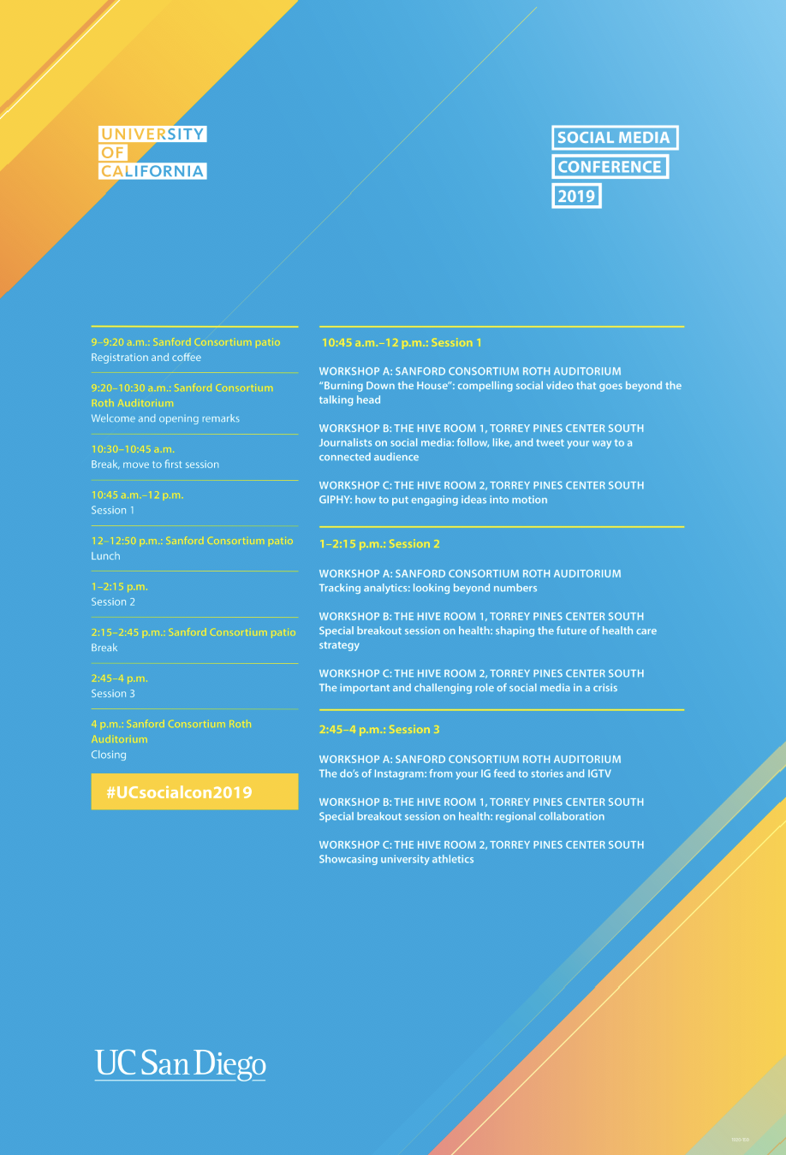
Overview

Slide 3
Integrating principles of equity, diversity and inclusion in social media
In our work, we should be mindful of…
How we regularly and authentically weave diversity into the stories we tell
Inaccurate representation or overrepresentation
Whether or not it is appropriate to call out identity
Implicit bias; try to have your content reviewed by another set of eyes before posting

Slide 4
Journalists on social media
Journalists look to different social media platforms to find stories, depending on their beats.
Some follow relavant hashtags on Twitter and Instagram (i.e. #CityHeights, #SanDiegoStyle); others find stories through community engagement; some through well-crafted PR pitches.
Tips to get their attention when pitching:
Brief email with links to more info
Do your research and only send relevant pitches to a reporter
Show a grasp of their scene and readership
Be mindful of deadlines. For example, print mags work months in advance while daily newspapers have a 1-day turn-around
Send all visual assets in one package (such as a Dropbox link) so they don’t have to follow up
Build some familiarity; follow and engage journalists in your beat on social, even if it’s not related to your work.
What not to do:
NO COLD CALLS
Don’t send the same pitch twice. If you follow-up on an ignored pitch, be creative.
Don’t send a pitch about something happening that day or the next day. Not enough time to plan.

Slide 5
GIPHY
GIFs are used across social channels and as stickers on Instagram
Use students to generate ideas for GIFs and create GIFs
Popular GIFs relate to school pride, student life, and events
Most popular GIFs only use type

Slide 6
Tracking Analytics
“Without data, you are just another person with an opinion.”
Native exports are the most accurate. Metrics are messy and there is no easy solution.
Make sure to give seven days lag time after a campaign or post to measure its full effect.
Consistency is everything – make sure you measure the same thing month to month in order to tell an accurate, detailed story
Not currently measuring your social performance month to month?
Total fans
Total monthly reach
Total monthly engagements
Total URL clicks
Total stories (posts) published

Slide 7
Shaping the future of health care strategy
Large-Scale Awareness Campaign
UCLA Health spent a year developing a colorectal cancer campaign #UCLAColonChampion
Built a team (cancer team, marcomm, physicians, leadership, fundraising, patient experience, influencers)
Created calendar and content (videos, links, questionnaires, photos, etc.)
Exceeded goal and gained followers
Develop YouTube Strategy
UC San Diego Health revamped the YouTube channel
Audited of videos and playlists
Removed outdated content, added relevant links to our services and reworked descriptions and titles
Rebranded our home page for Open Enrollment
Increased subscribers (from 19,000 to 50,000 in a year) and traffic to website

Slide 8
The do’s of Instagram
Instagram has the most potential for growth and biggest reach on social, primarily through IG stories.
Do what works for your community and brand. (What type of photo performs the best?)
Useful tools (most require a subscription):
Mish Guru - allows you to schedule stories in advance, manage Instagram “takeovers” by students and staff, tracks metrics.
Tint - allows you to request photos and get permissions handled for user-generated content.
Tap.bio - customizes link in bio. Links to tree w/ multiple links, stories, etc.
Unfold and UNUM - Free apps that allow you to plan your feed and create video/photo layouts for stories.
IGTV - always evolving and worth experimentation.
New feature: IGTV Series
“Video is everything” - keep this in mind always!
.

Slide 9
Health - Regional collaboration
Roundtable discussion involving UC Health social media managers
Policies, such as HIPAA training and risk management
Managing online reviews
Content management systems (Hootsuite, Buffer, Sprout, Falcon, Social Studio)
Monthly phone call
Project collaboration
Share best practices
Benchmarks
Social media tools
Formal training

Slide 10
University athletics
Key takeaways from scholar-athlete
Looking at team, athletics and university social accounts to make decision about what university is the best fit. Could I see myself there?
UCLA uses dropbox folder system to make sure student-athletes have access to all related photos of them and their team
Student athletes are ambassadors, posting these photos and spreading the word to increase game attendance, school pride, and recognition of the program
Let scholar-athletes generate content ideas and provide resources to help them execute them

